Slide 1


Slide 2
The Human Brain and Neural Networks
Smart scientists have been figuring even today that how human brain works.
Tiny part of brain that lets do things and smart things are called neurons.
Communicate via impulsive signals called synapses which helps us think.
Same idea is of neural networks.

Slide 3
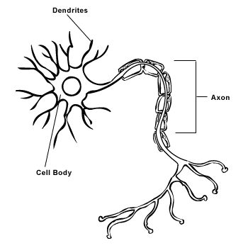
Synapses
Notes:
Human Artificial
Neuron Processing Element
Dendrites Combining Function (Activation function)
Cell Body Transfer Function (Summation)
Axons Element Output
Synapses Weights

Slide 4
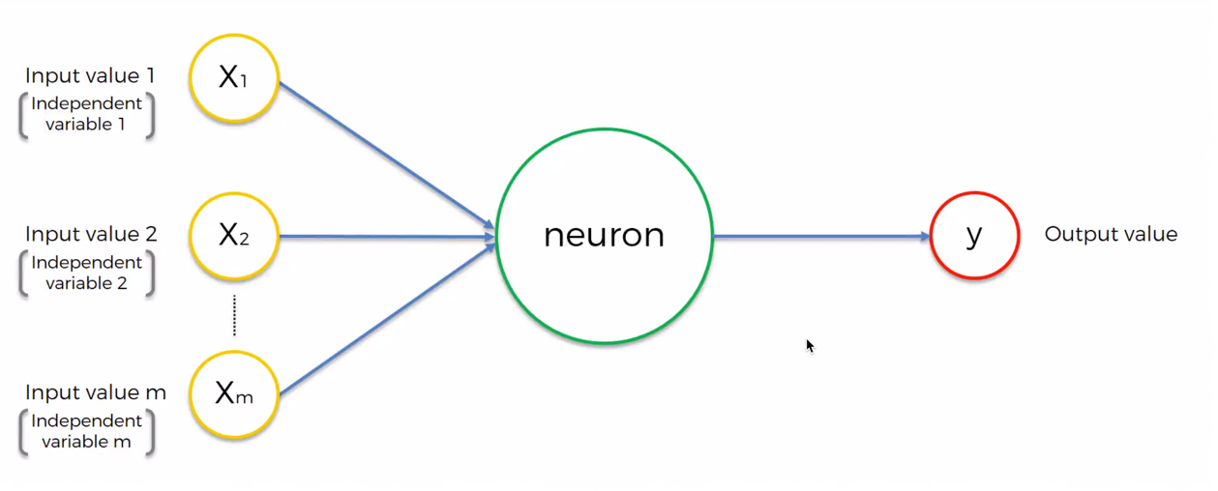
ANN Intro

Slide 5
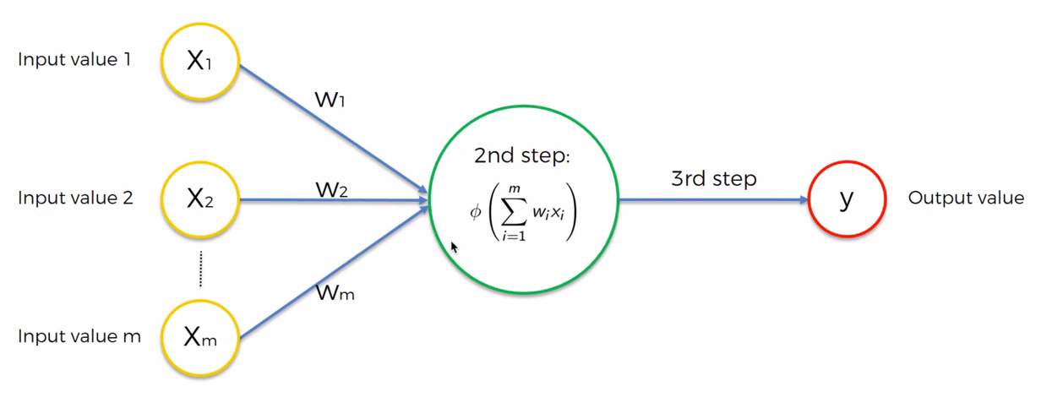
Notes:
Human Artificial
Neuron Processing Element
Dendrites Combining Function (Activation function)
Cell Body Transfer Function (Summation)
Axons Element Output
Synapses Weights

Slide 6
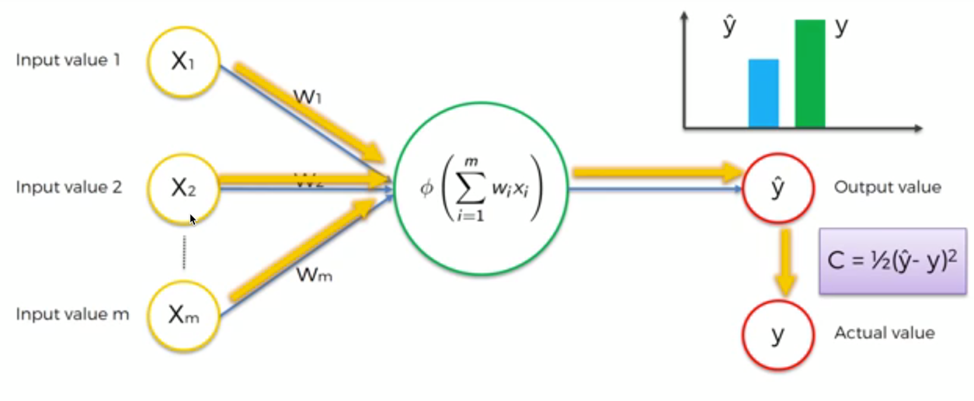
How does ANN learn

Slide 7
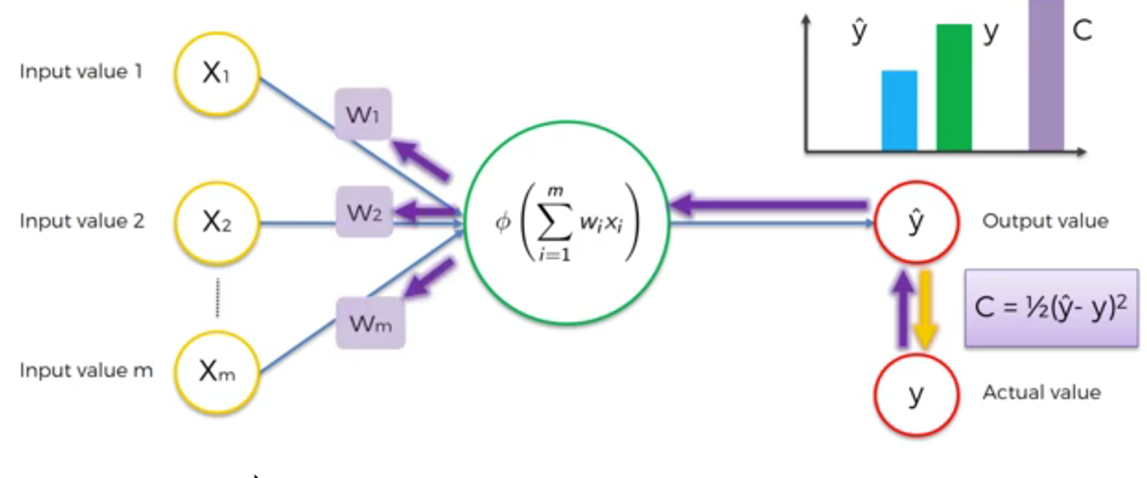

Slide 8
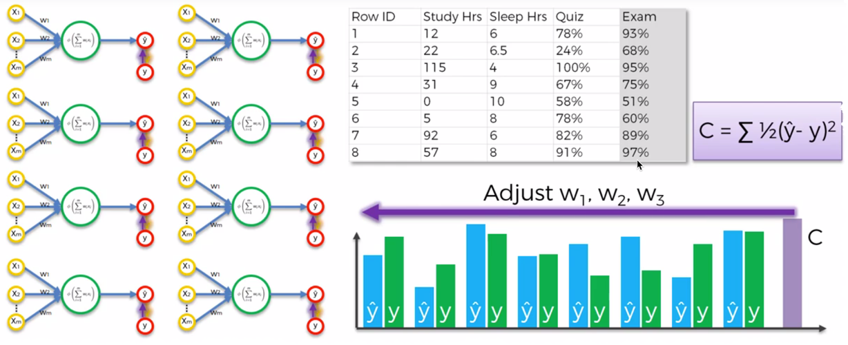

Slide 9
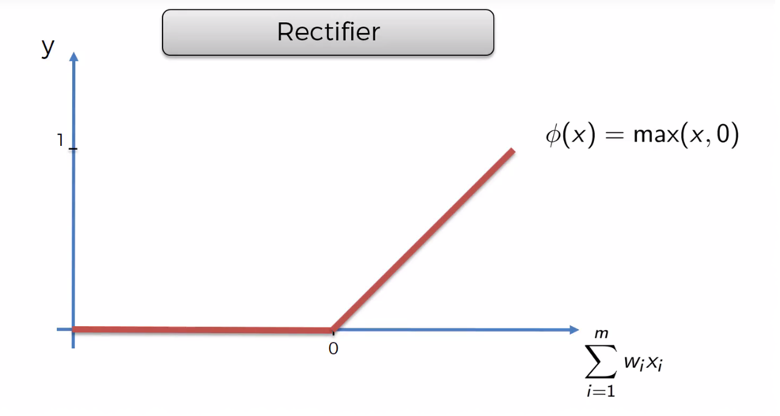
Relu Activation function

Slide 10
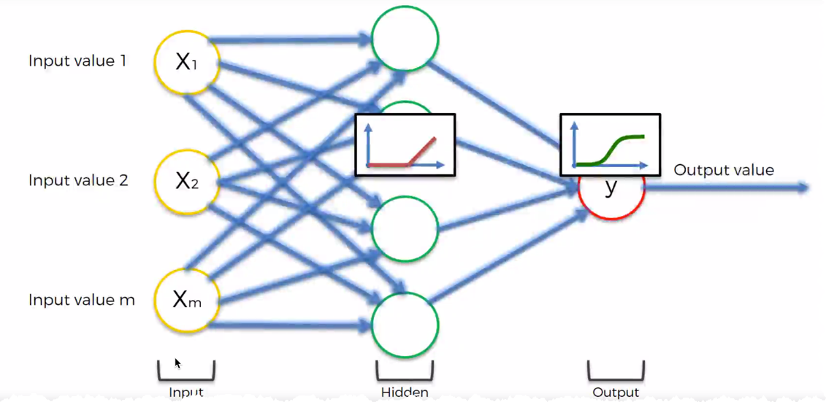

Slide 11
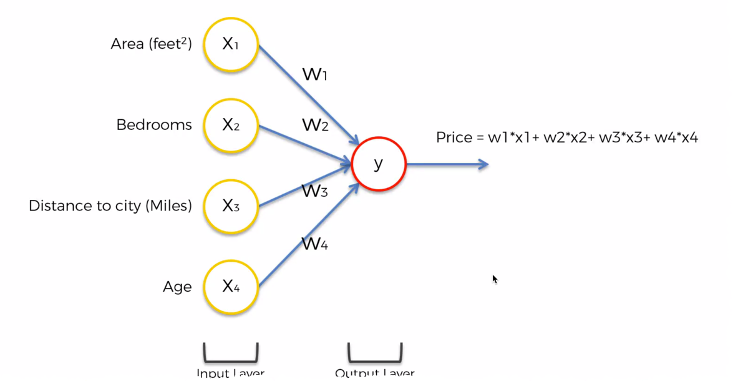

Slide 12
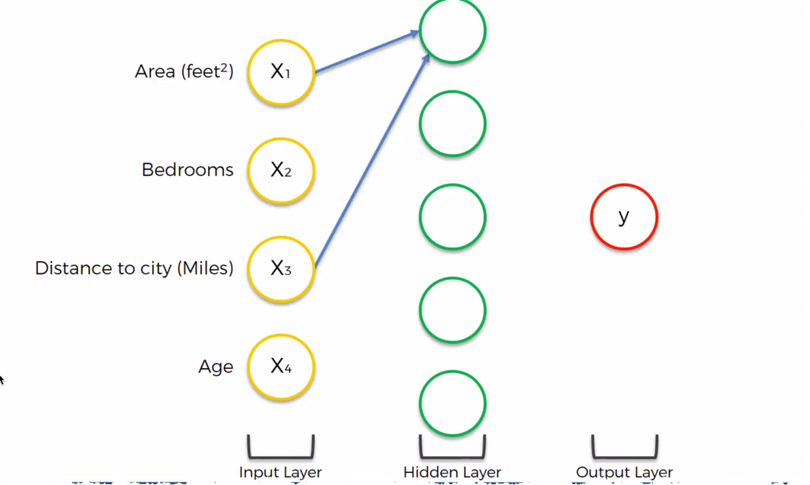

Slide 13
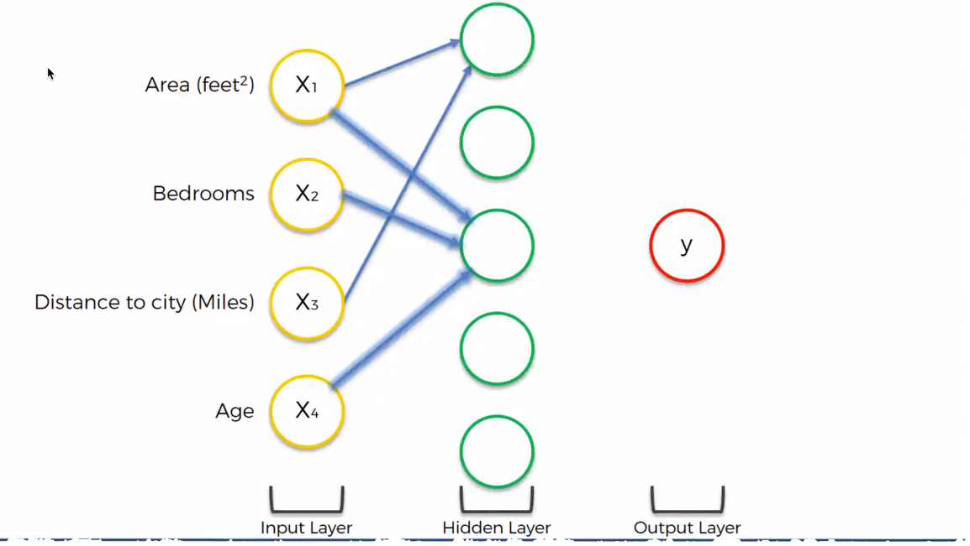

Slide 14
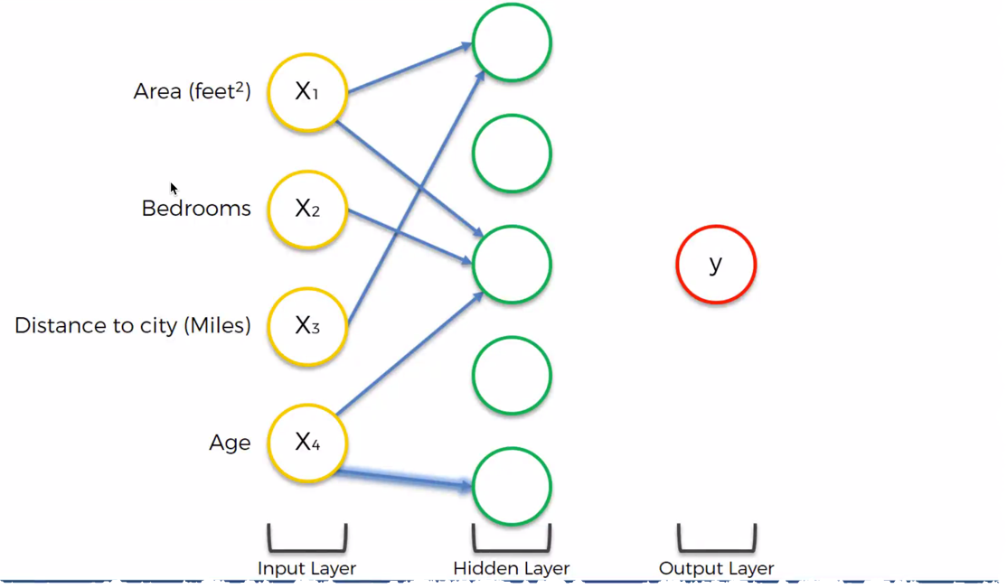

Slide 15
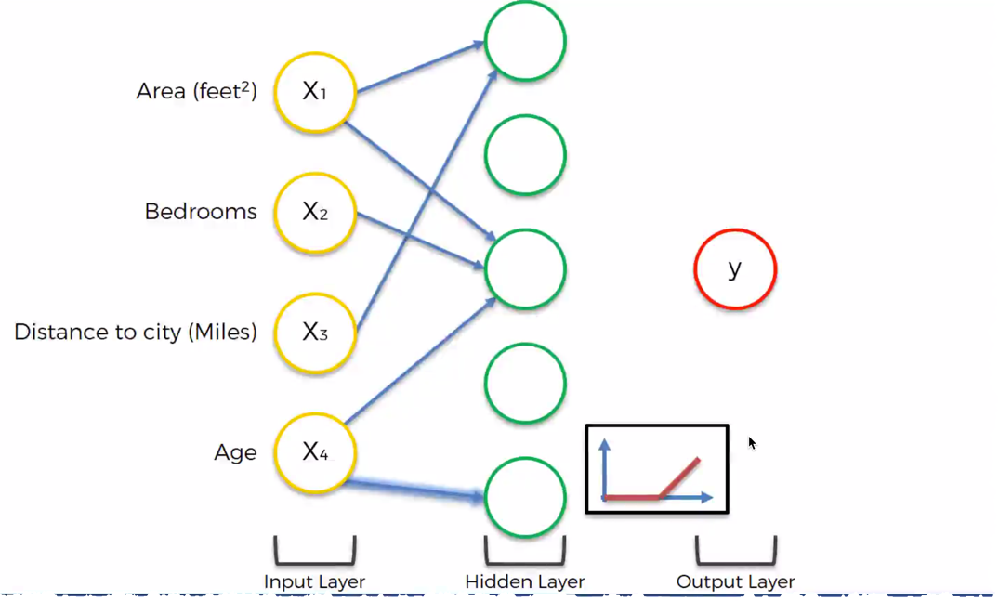

Slide 16
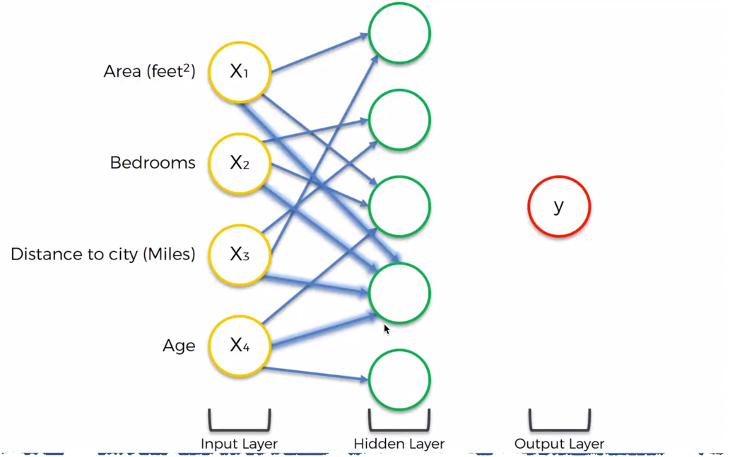

Slide 17
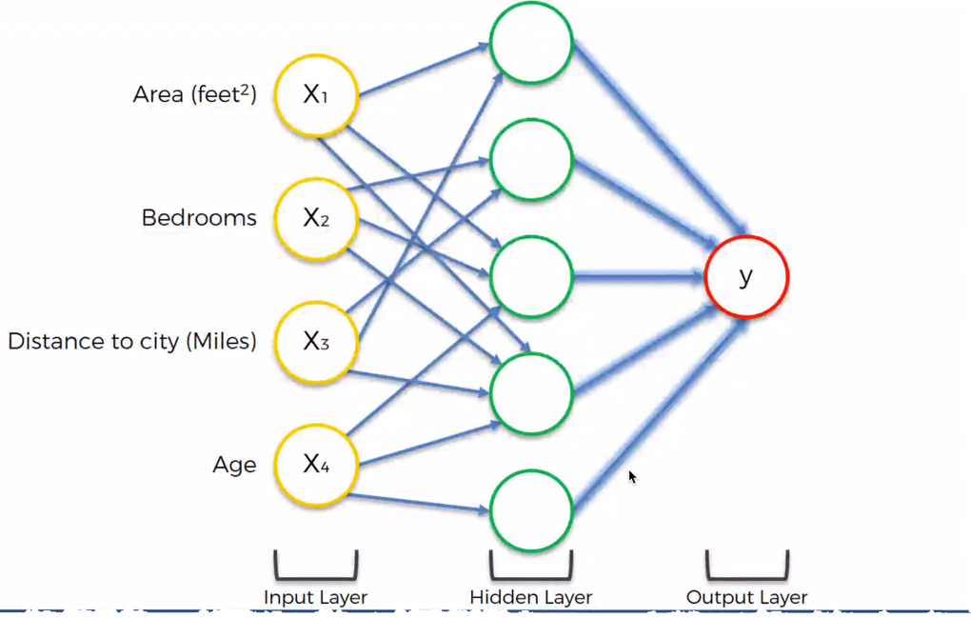

Slide 18
Other Intuitions
Categorical data using label and one hot encoder to remove bias
Feature scaling (minimize Euclidean distance bias) to ease calculation using StandardScaler
Sequential – initialize model
Dense – add layers to model

Slide 19
Practice time

Slide 20
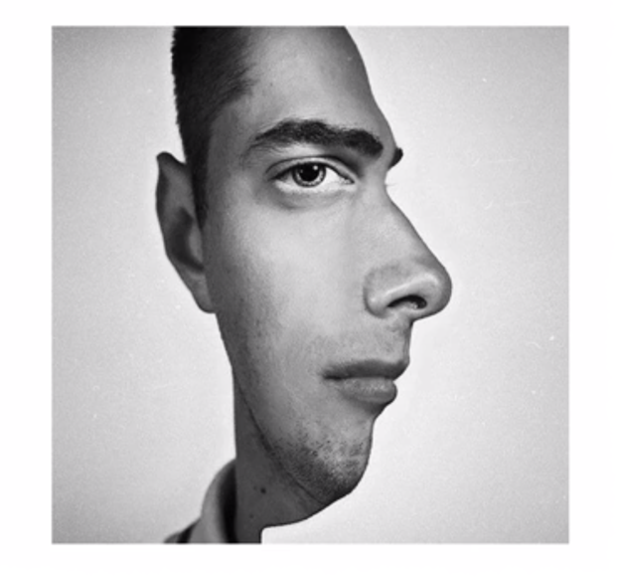
CNN Intro

Slide 21
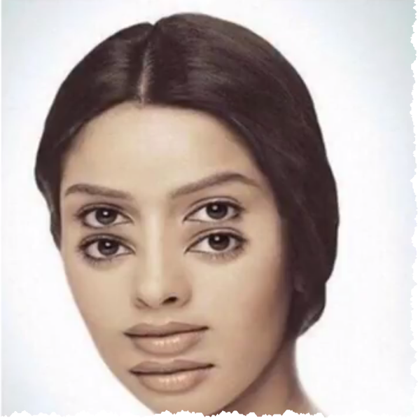

Slide 22
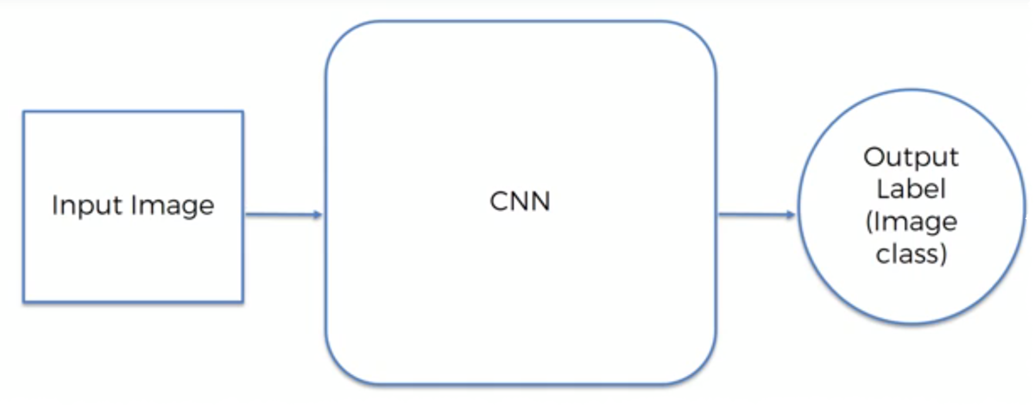

Slide 23
Layers
Convolution layer – feature detector
Pooling layer – spatial invariance
http://scs.ryerson.ca/~aharley/vis/conv/flat.html
Flattening – as we need to push it to ANN
Fully Connected

Slide 24
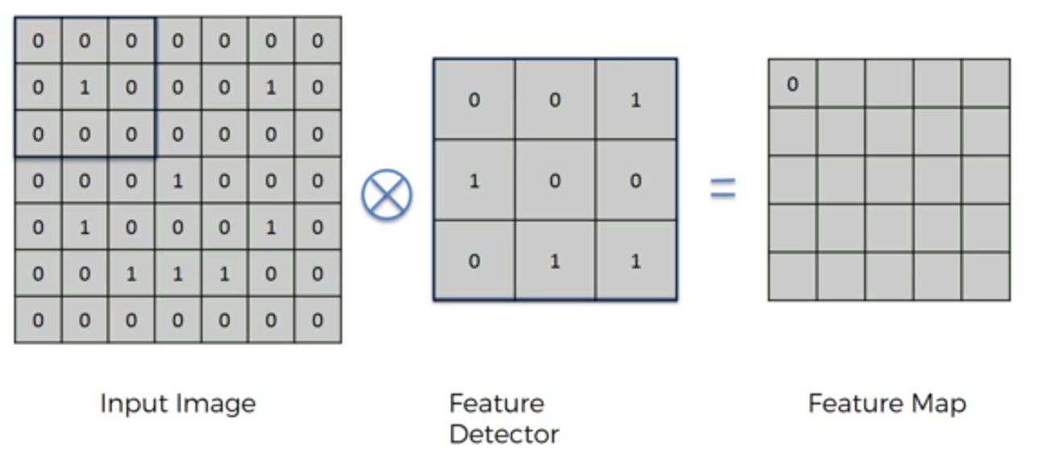
Convolution – feature detector

Slide 25
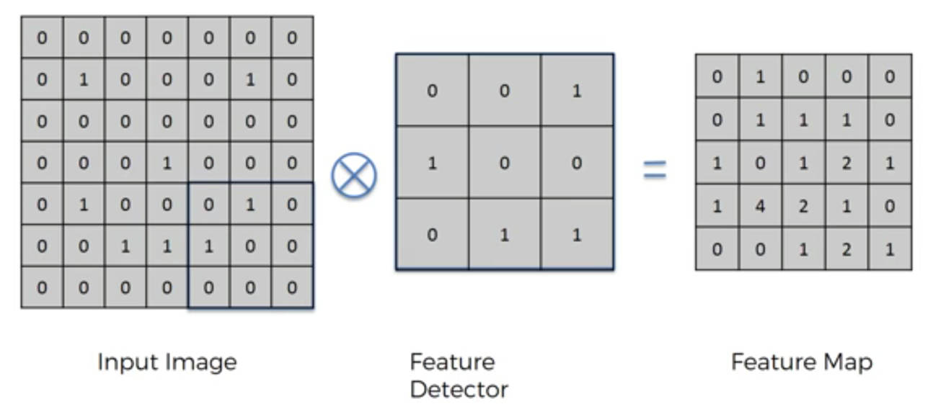

Slide 26
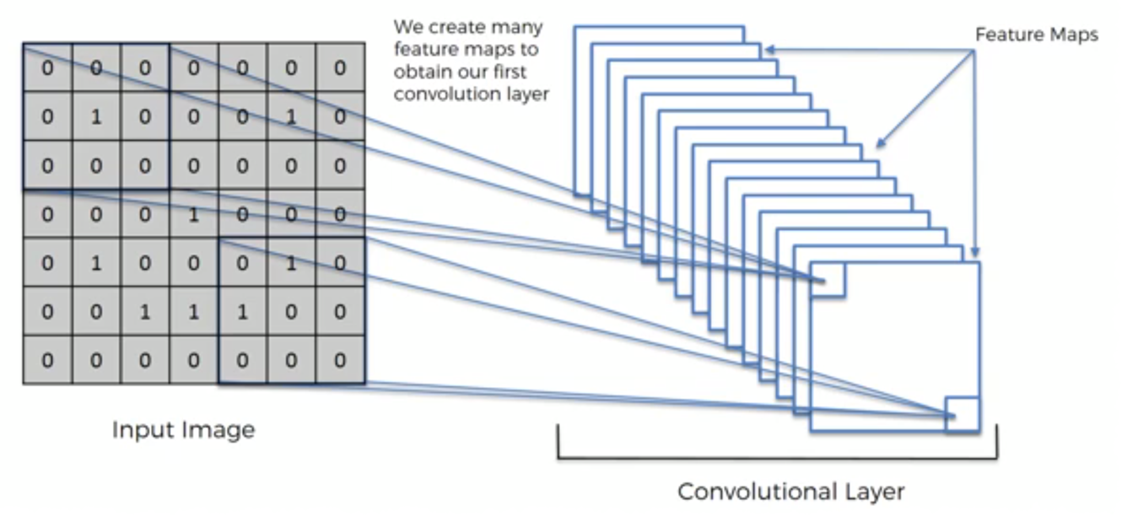

Slide 27
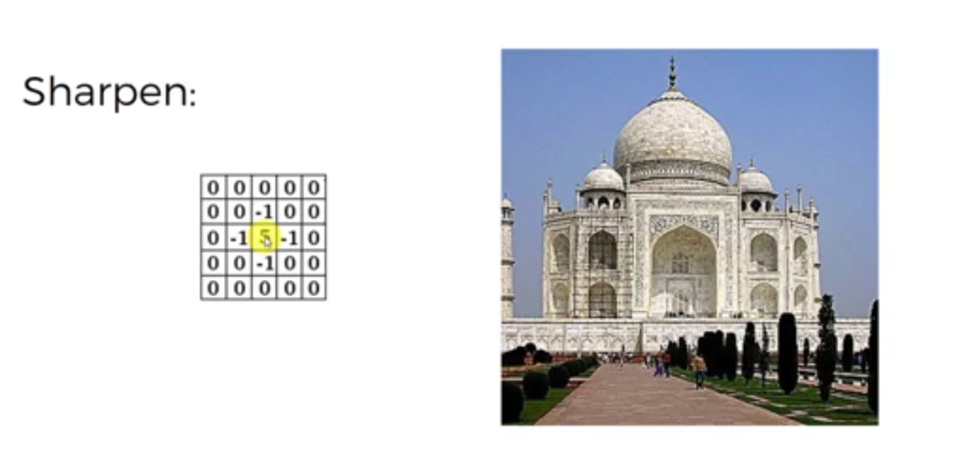

Slide 28
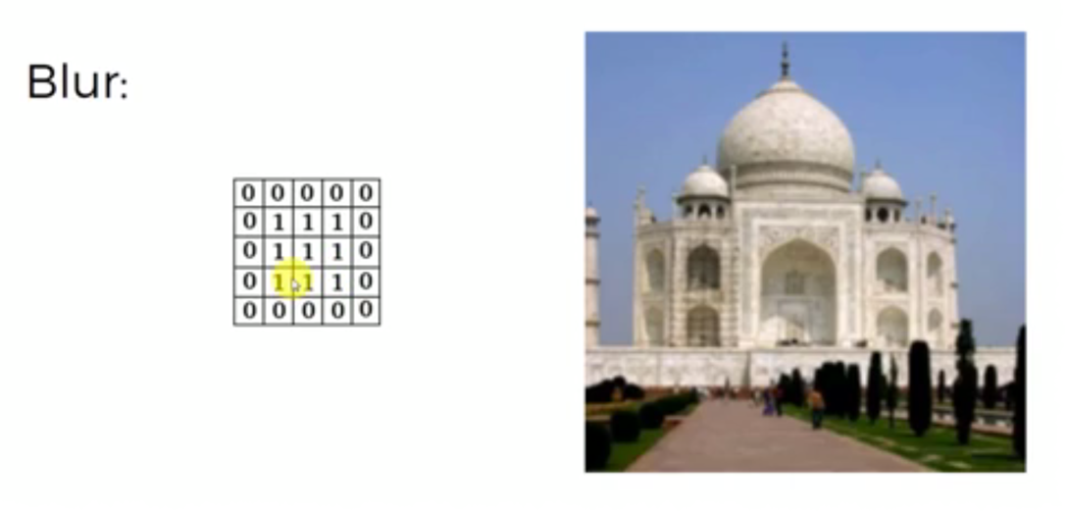

Slide 29
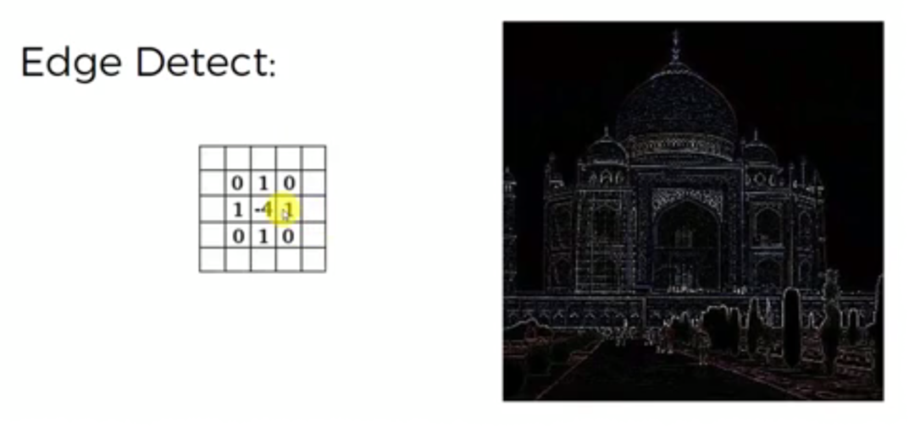

Slide 30
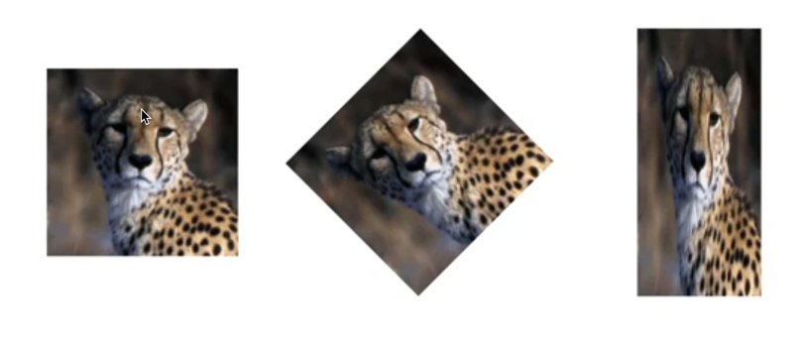
Max Pooling – spatial invariance

Slide 31
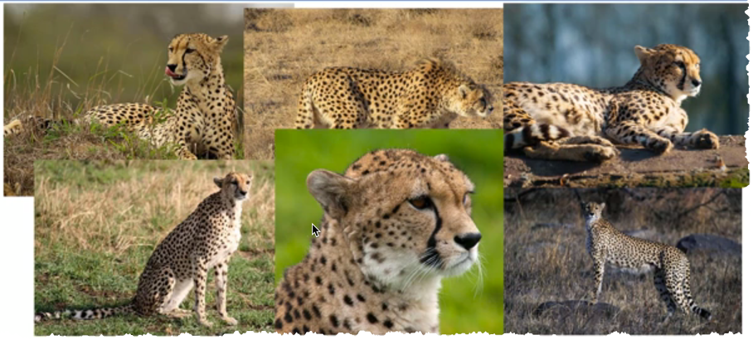

Slide 32
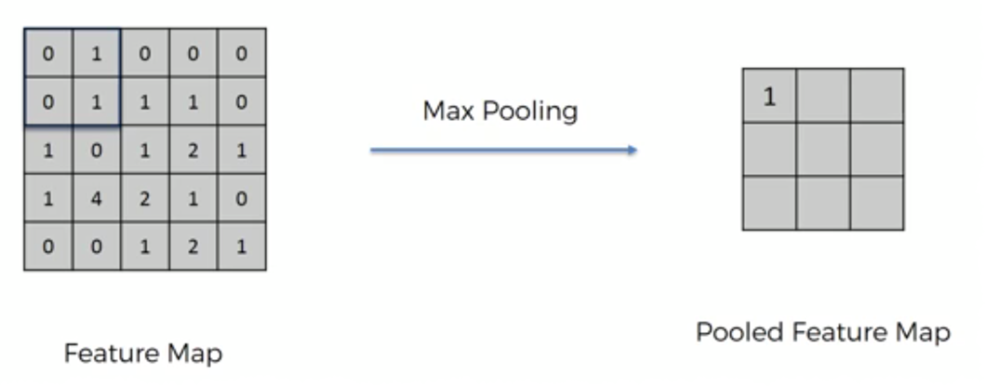

Slide 33
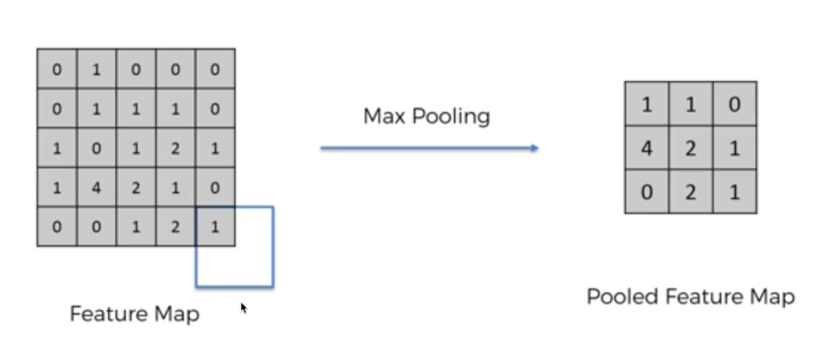

Slide 34
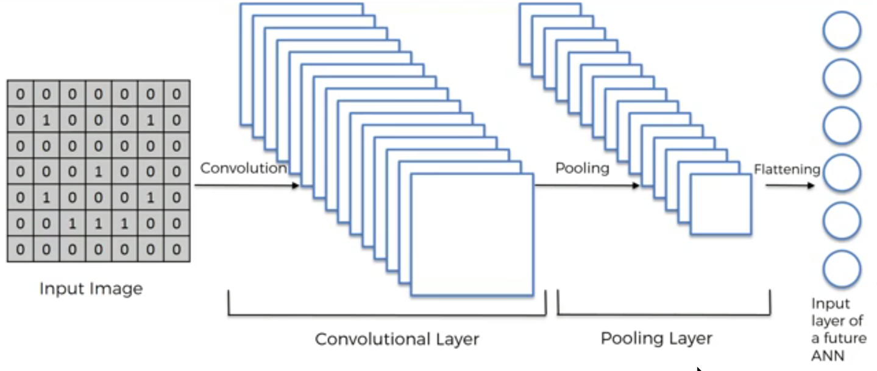

Slide 35
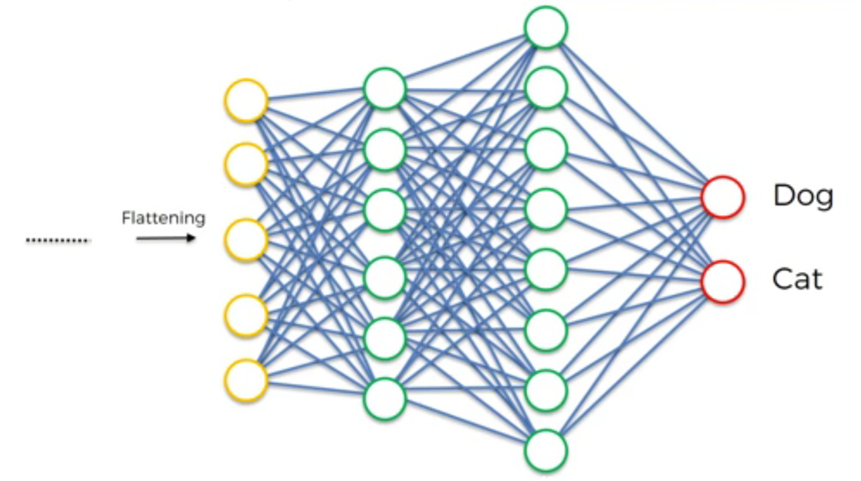

Slide 36
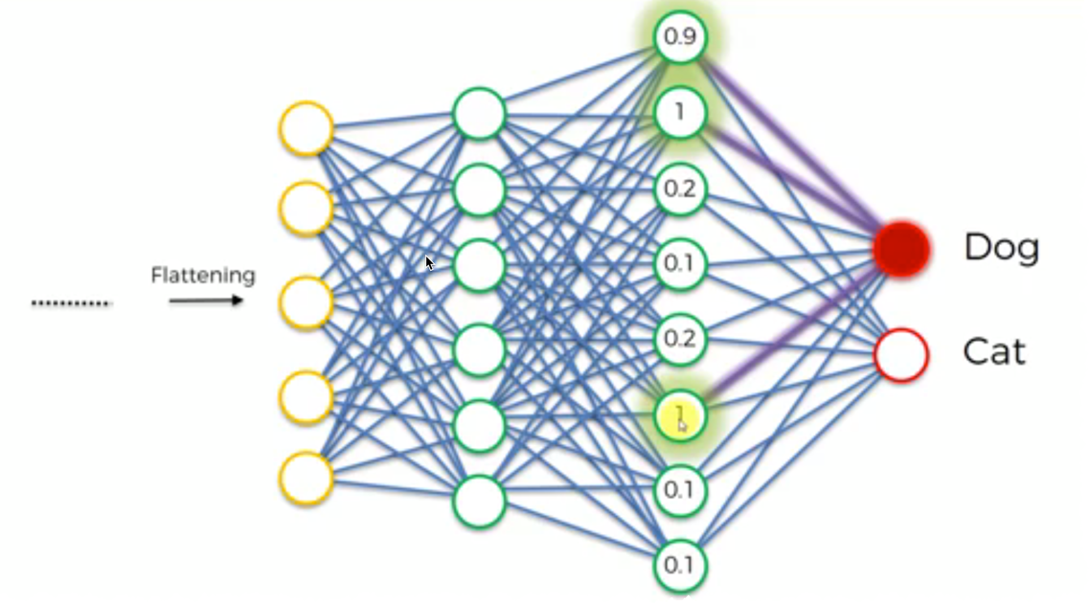

Slide 37
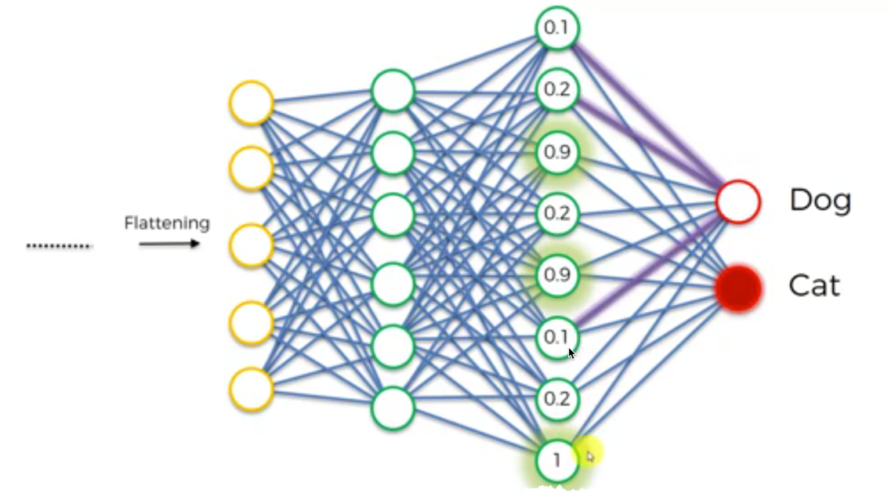

Slide 38
CNN Intuitions
Convolution layer – feature detector
Pooling layer – spatial invariance
http://scs.ryerson.ca/~aharley/vis/conv/flat.html
Flattening – as we need to push it to ANN
Fully Connected

Slide 39
Model reuse
Save model
Save weights
Reuse it

Slide 40
Practice time

